Slide 1
NORTH SOUTH UNIVERSITY
Lecture 06
PHI 104
Introduction to Ethics

Slide 2
Normative Ethics:
Consequentialism/ Utilitarianism

Slide 3
One way of thinking about this is to compare the benefits and costs of each alternative. Whichever has the greater net benefit is the best alternative.

Slide 4
Such an approach begins with the belief that we can measure and compare the risks and benefits of various actions. The idea is that actions are morally better or worse depending on whether they produce pleasure or pain or, more abstractly, on how they affect human well-being and happiness. Unlike egoism, utilitarianism focuses on the sum of individual pleasures and pains. It is not my pleasures or pains that matter—but the cumulative happiness of a number of people.

Slide 5
Utilitarianism suggests that we ought to consider the totality of consequences of a policy or action. Forms of utilitarianism will differ depending on how we understand what sorts of consequences or interests matter. Complexities arise in defining key concepts such as happiness, interest, and well-being.

Slide 6
Utilitarianism has to provide an account of whose interests or happiness matters. Jeremy Bentham, one of the founding fathers of utilitarianism, extended his utilitarian concern in a way that included all suffering beings, including nonhuman animals.

Slide 7
The classical formulation of utilitarian moral theory is found in the writings of Jeremy Bentham (1748– 1832) and John Stuart Mill (1806–1873).

Slide 8
Utilitarianism: Bentham

Slide 9
Jeremy Bentham (1748-1832)
An Introduction to the Principles of Morals and Legislation (1789)

Slide 10
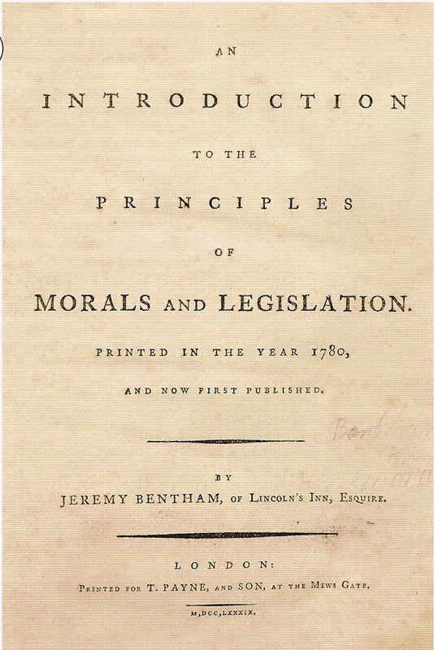

Slide 11
“The greatest happiness for the greatest numbers”

Slide 12
Bentham holds that pleasantness is the only quality because of which an experience is good or valuable.

Slide 13
“Each man ought to seek his own maximum pleasure”.

Slide 14
In estimating the amount of pleasantness caused by an action, seven factors need to be taken into consideration:

Slide 15
1. Intensity
2. Duration
3. Certainty
4. Propinquity: the nearness in time of the pleasant result.
5. Fecundity: the power of the pleasant experience to produce further pleasant experiences.
6. Purity: freedom from intermixture with unpleasant experiences
7. Extent: the number of persons affected by it

Slide 16
The Hedonic Calculus
Bentham also wanted a theory that considered all people (the ‘greatest number’) when making laws or moral decisions. He came up with the idea of a ‘hedonic calculus’ that could measure different amounts of pleasure. The calculus used seven aspects of pleasure that Bentham thought could be measured. If an action has high amounts of these seven things, then it should be followed. The hedonic calculus included:

Slide 17
Remoteness – how near it is
Purity – how free from pain it is
Richness – to what extent it will lead to other pleasures
Intensity – how powerful it is
Certainty – how likely it is to result
Extent – how many people it affects
Duration – how long it lasts

Slide 18
Some Utilitarian philosophers would argue that there are situations when you can use the hedonic calculus as a method of determining the overall effects of an ethical decision or action. For example, these could include choosing how to spend National Lottery money (a playground used by 1,000 children or a stair-lift for 10), or in deciding how to prioritise health care spending, including what procedures should be carried out in a hospital (4 X-ray units or 1 machine used for laser eye surgery).

Slide 19
A good example of Act Utilitarianism is this: when faced with a road traffic accident a paramedic will treat a pregnant woman first. This is because in any given situation, the pregnant woman and her unborn child have a greater potential for future happiness than any individual involved in the crash. Not only are two people treated, but the unborn child may live a longer life than the other casualties. This is both quantity focused and a teleological approach.

Slide 20
Utilitarianism: Mill

Slide 21
John Stuart Mill
Utilitarianism (1861)

Slide 22
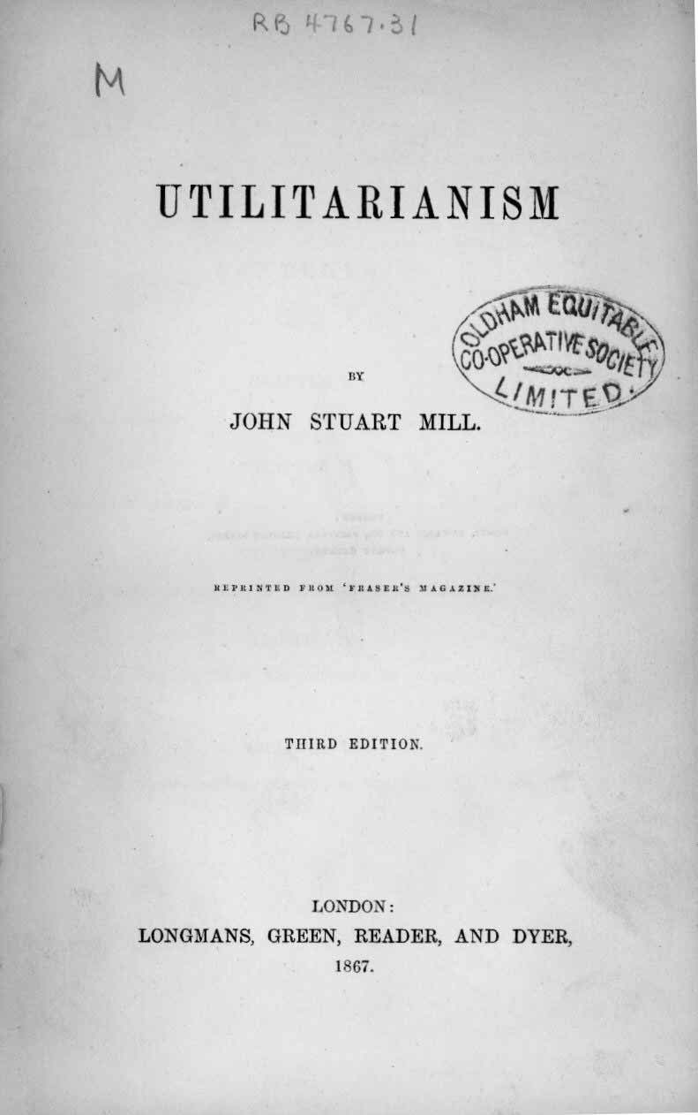

Slide 23
Mill’s account of utilitarianism may be summarized in the five statements:

Slide 24
1. Pleasure is the only thing that is desirable.

Slide 25
2. The only proof that a thing is desirable is the fact that people do actually desire it.

Slide 26
3. Each person’s own pleasure or happiness is a good to that person, so the general happiness is a good to everybody.

Slide 27
4. Men do desire other objects, but they desire them as a means to pleasure.

Slide 28
5. If one of two pleasures is preferred by those who are completely acquainted with both we are justified in saying that this preferred pleasure is superior in quality to the other.

Slide 29
The moral end is not merely the maximum amount of happiness but “the greatest happiness of the greatest number”.

Slide 30
Exercise
Peter, a 32 year old, suffered horrific injuries as the result of the collapse of a bridge over which he was driving his car. He has been classified as being in a persistent vegetative state for the past five years. Although Peter’s brain stem is still functioning, his heart is beating and he can breathe spontaneously, he is dependent on oral feeding for the continuation of his life. The doctors in charge of his case have come to the decision that Peter’s life is no longer of value to him and have requested that they be allowed to withdraw his food supply. It is legal for doctors to withdraw medical support, however, feeding a patient is regarded as part of palliative care and not a medical treatment. Peter’s parents have taken the case to court in order to prevent his doctors from withdrawing his feeding tubes. What decision would you advise the judges to make in this case?

Slide 31
Class Work
Ethical Problem Analysis: 5G
Should we implement 5G Technology?
1gigabit/sec. speed
Faster speed of thought robotic communication
More self-efficient driving cars
Digital divide deepens
It will require an enormous amount of energy to run

Slide 32
Ethical Problem Analysis:
Social Credit Systems
a personal scorecard for every person and business in China, based on their level of trustworthiness, and
that participation would be mandatory for every Chinese citizen by the year 2020.
it will attempt to rate people in four areas: “honesty in government affairs” “commercial integrity” “societal integrity” and “judicial credibility” .

Slide 33
PROBLEMS?

Slide 34
1. The imperative to maximize happiness whenever possible is too strict. There are many instances where I could create more happiness by doing act a rather than act b, but where act b is still morally permissible. For instance, I could buy milk for two families in Africa with the ten dollars I spend on a movie ticket. But it’s crazy to think that I’m doing something wrong every time I go to the movies.

Slide 35
2. Sometimes maximizing happiness seems more than just right. Suppose I jump on a hand grenade to save four of my fellow soldiers in battle, and get killed in the process. What I did wasn’t just right, but was above the call of duty. But since utilitarianism says that the only right acts are the ones that maximize happiness, Mill can’t acknowledge the heroism of my act. He has to say that it was the only right thing to do, and that sounds strange.

Slide 36
3. How are we supposed to calculate the utility for any given situation? We can’t predict the future, and even if we could, there are so many factors to most situations that it seems impossible for us to ever have a good idea of what the best possible consequence will be.

Slide 37
4. Utilitarianism seems to require us to do things that are not obviously morally permissible. I can sometimes increase the overall happiness in the world by doing awful things (stealing, murdering, lying, etc.) Moral theories should not condone this sort of behaviour.

Slide 38
THANK YOU!!!

